Slide 1

Leandro Bracho Nicholas Joseph Oscar Medrano Robin Smithson
Arbitrary Waveform
Generator – Status Update

Slide 2
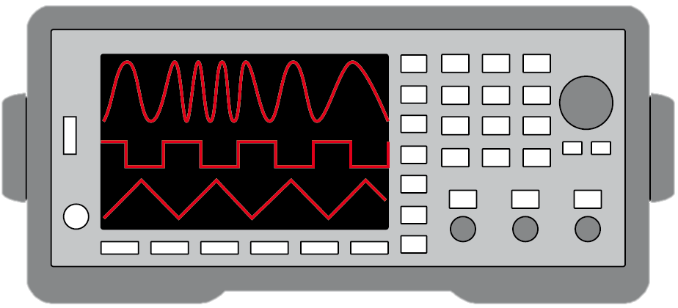
Project Description
Problem Statement:
Test validation is a vital step in the design and fabrication of circuit boards for any project in the realm of electrical engineering.
Typical AWGs can be large and unintuitive
Solution Proposal:
Create a mobile user interface for the AWG
Design an AWG with decent quality
Allow hand drawn waveforms
Notes:
Nick

Slide 3
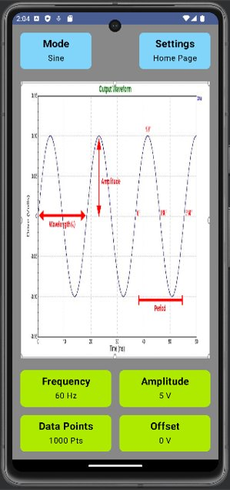
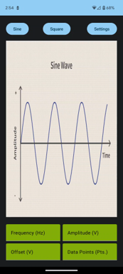
Android Interface
UI Improvements
Editable Text Fields
Clickable Buttons
User Input
Three Weeks Ago
Current App

Slide 4
Microcontroller Progress
All parts have been ordered
Initial schematic designed in Altium
PCB design in progress

Slide 5
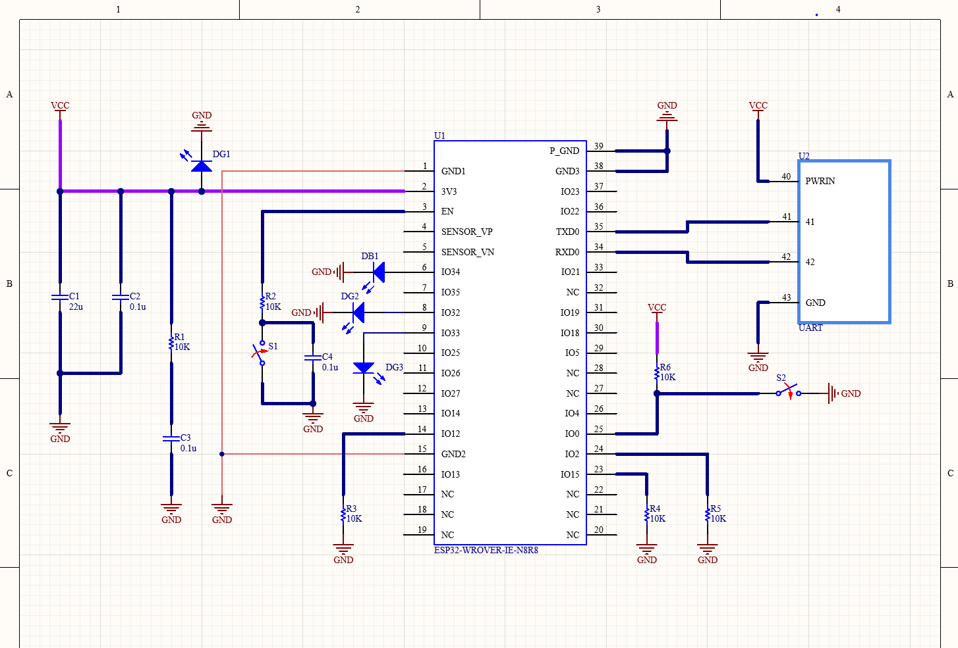

Slide 6
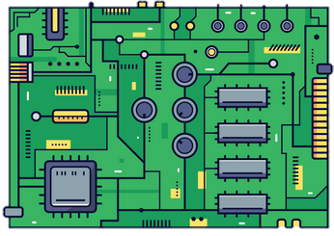
FPGA
Have schematic design almost completed
Need to complete the PCB design

Slide 7
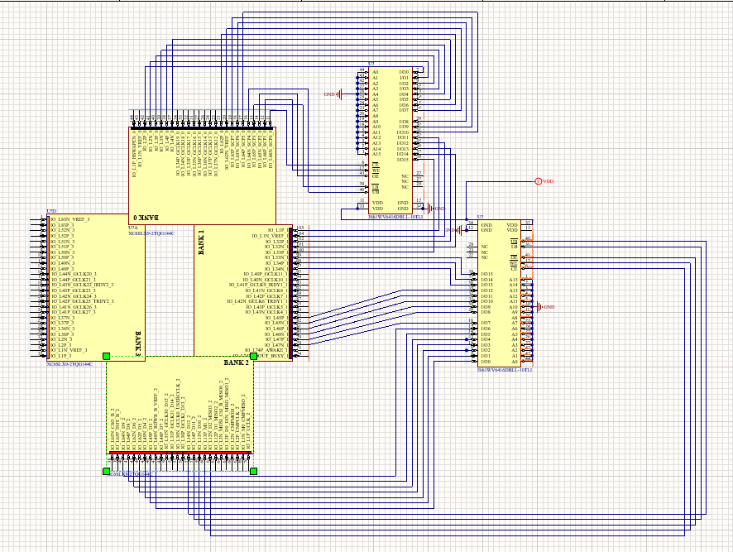
FPGA

Slide 8
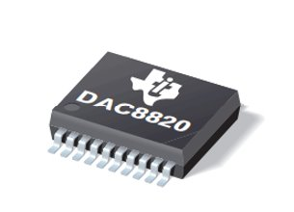
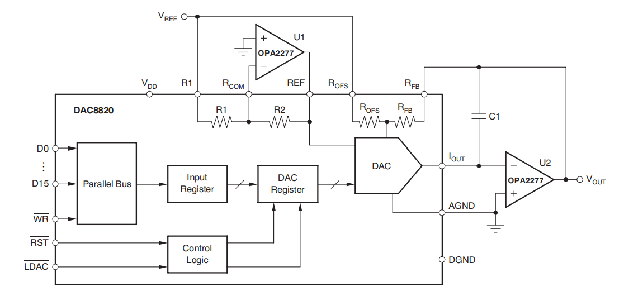
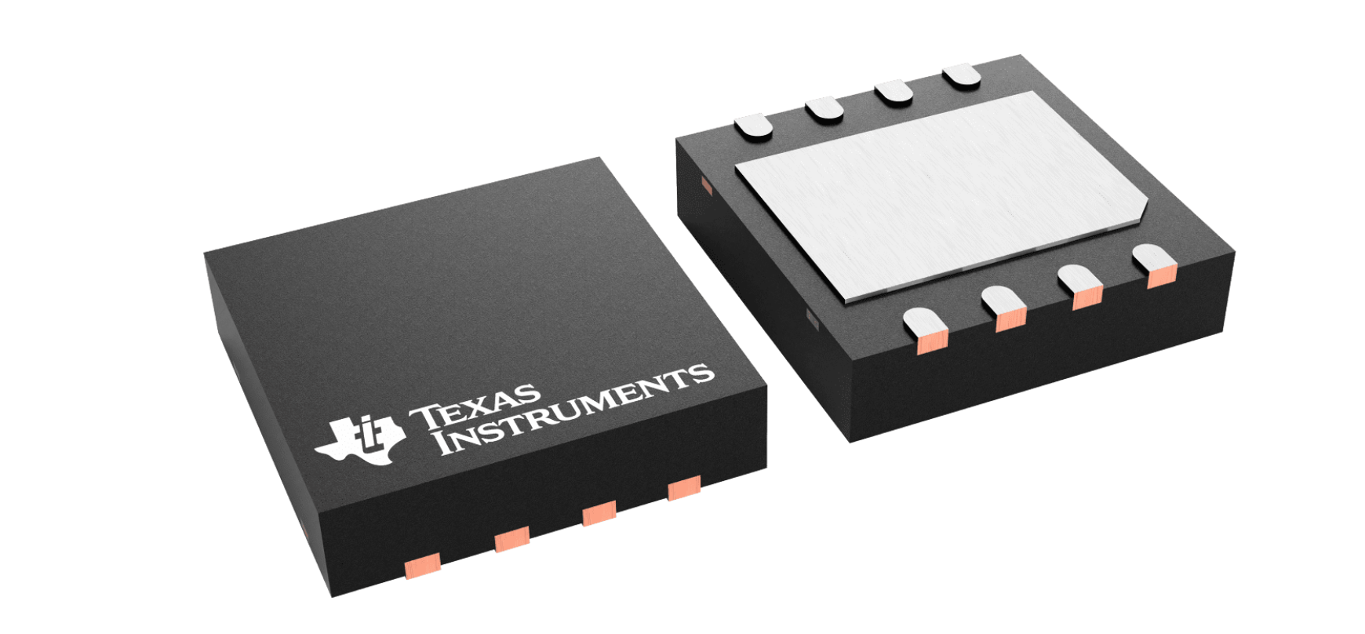
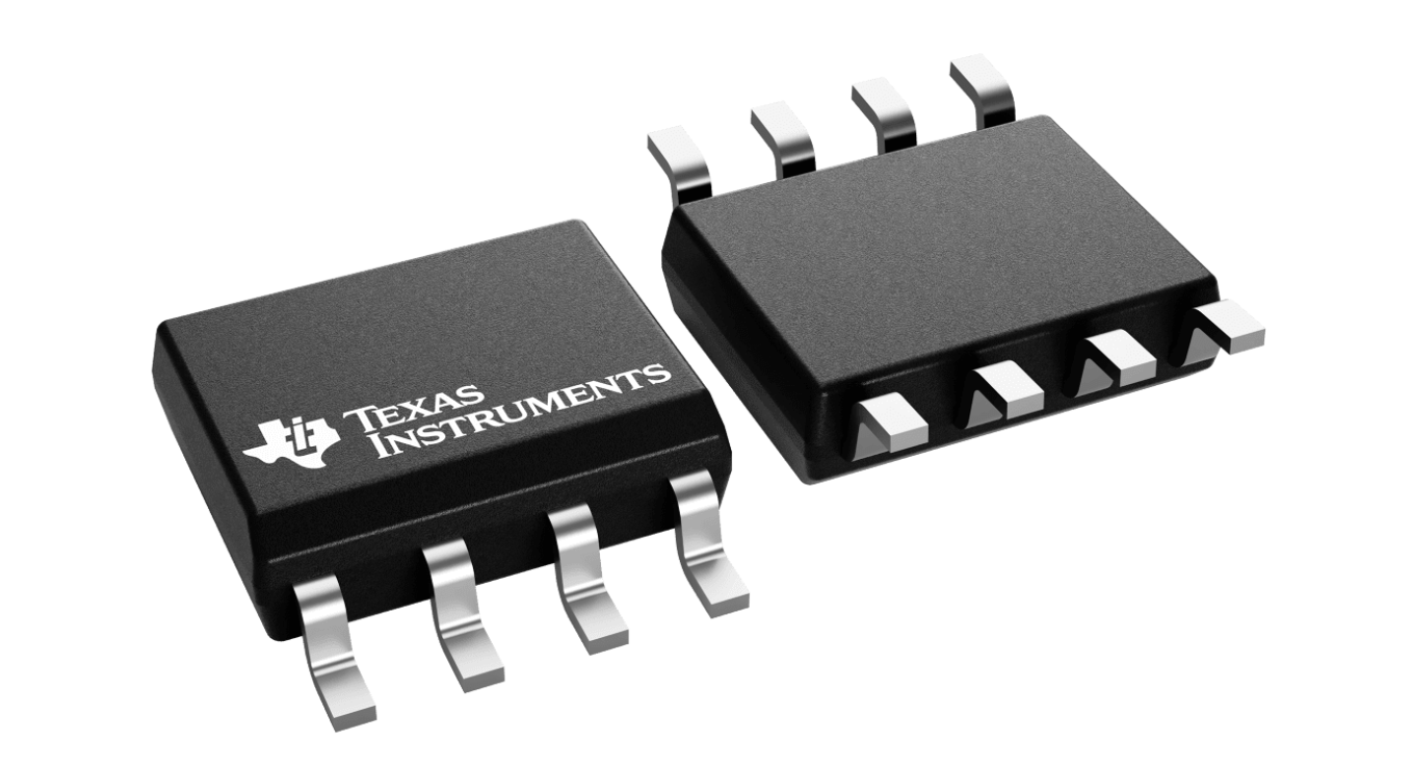
Bipolar Output Circuit
DAC8820 and OPA2277 make up the bipolar output circuit.
Will use an AD2 to power and input data into the circuit.
Schematic and PCB design done for one channel.
Have not ordered PCB and am waiting approval for the OPA2277.

Slide 9
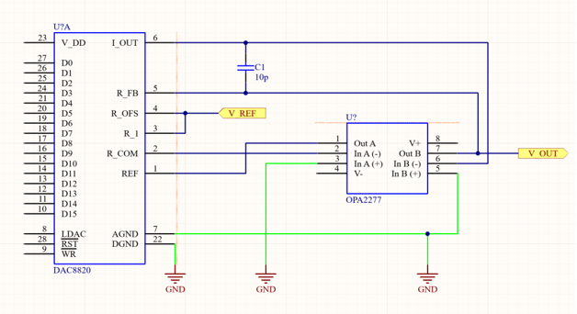
Bipolar Output Circuit
A 24-position connector will be used to connect the AD2 to the DAC8820.
Ideally will have a BNC connector but will hold on until final board.

Slide 10
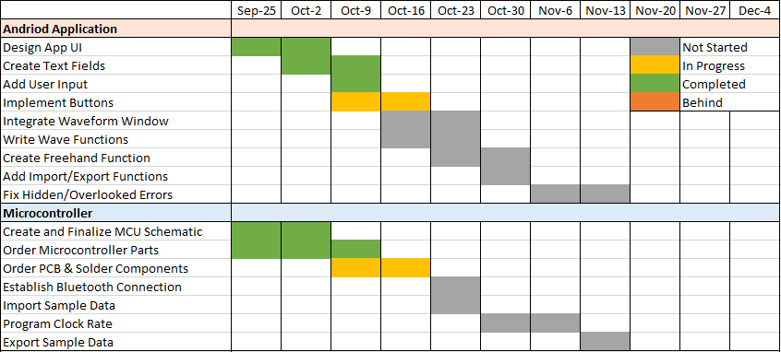
Execution Plan

Slide 11
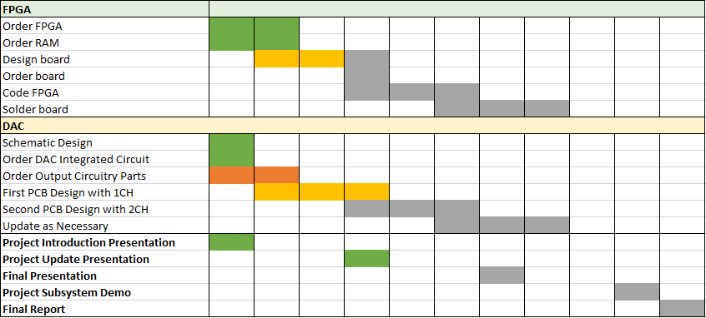
Execution Plan Cont.

Slide 12
Validation Plan
Paragraph # | Test Name |  | Success Criteria | Methodology | Status
 | Leandro Bracho
3.2.1.1 | UI Design |  | The UI appears correctly in portrait and landscape modes | The app will be launched on the phone and will be viewed in both portrait and landscape mode | TESTED
3.2.1.1 | Buttons |  | Each button is fully functional | Each button will be pressed to determine if it is clickable, and the available options are switchable | UNTESTED
3.2.1.2 | Functions |  | Each function can produce a wave | Each function will be called on and given preset data to achieve the correct wave output | UNTESTED
3.2.1.2 | User Input |  | The application can take user inputs | The buttons and functions will be selected, and the user will give data that should appear in the app | TESTED
3.2.1.2 | Freeform |  | The freeform function can be successfully used | The freeform mode will be selected, and the user will attempt to draw a wave by hand | UNTESTED
3.2.1.2 | Import |  | The app can import a csv file filled with data | A sample csv file will be uploaded to the app with the "Import" option and should update all values. | UNTESTED
3.2.3.2.1 | Export |  | The app can export a csv file filled with data | After a wave has been edited, the file will be exported to the phone using the "Export" option. | UNTESTED

Slide 13
Validation Plan Cont.
Paragraph # | Test Name |  | Success Criteria | Methodology | Status
 | Nicholas Joseph
3.2.1.2 | FPGA input |  | The FPGA is written to correctly | Using a coding language write tests to validate that the input leads to the expected results | UNTESTED
3.2.3.2.1 | FPGA output |  | The FPGA reads out correctly | Using a coding language write tests to validate that the output leads to the expected results | UNTESTED
3.2.3.2.1 | SRAM Comm |  | The FPGA is able to communicate with the RAM | Have an input write to the S ram, have an oscilloscope measure that there is an input to the RAM | UNTESTED
3.2.3.2.1 | Writing to Ram |  | The FPGA can write to the ram | Have the FPGA write to the RAM , measure with an oscilloscope | UNTESTED
3.2.3.1 | Reading from Ram |  | The ram reads back to the FPGA the correct values | Have a read write cycle run from the FPGA to the RAM and back, ensure the numbers match | UNTESTED
3.2.3.1 | Correct Timing |  | The timing reading to and from the FPGA is correct | Have multiple cycles run and ensure erroneous errors do not pop up in the system | UNTESTED
3.2.3.2.2 | FPGA + DAQ |  | The hole system reads in and out correctly | Run system from start to finish and ensure the expected measurements are happening | UNTESTED

Slide 14
Validation Plan Cont.
Paragraph # | Test Name |  | Success Criteria | Methodology | Status
 | Oscar Medrano
3.2.3.2.1 | DAC Output |  | DAC outputs the expected unbuffered current. | The DAC will receive a digital signal and output the unbuffered current. | UNTESTED
3.2.3.2.2 | I/V Converter |  | I/V converter can convert a current to a voltage. | I/V converter will receive a current input and output the expected voltage. | UNTESTED
3.2.3.2.2 | DAC + I/V |  | Integrated DAC and I/V will output expected waveform. | The I/V converter will output the waveform from the DAC output current. | UNTESTED
3.2.3.3 | Second Channel |  | Update circuitry to output 2 expected waveforms. | Input 2 digital signals to the DAC and output 2 expected waveforms. | UNTESTED

Slide 15
Validation Plan Cont.
Paragraph # | Test Name |  |  |  | Methodology | Status
 | Robin Smithson
6.1.1 | Bluetooth |  |  |  | The MCU successfully turns on Bluetooth | The MCU will have a blue LED on its board that will light up when the Bluetooth control has succesfully turned on. | UNTESTED
3.2.1.2 | Inputs |  |  |  | The MCU successfully imports sample data points | A green LED will be added to the MCU board that will light when all data points have successfully imported. | UNTESTED
3.2.3.2.1 | Data Output |  |  |  | The MCU successfully exports all data points | A second green LED will light when all data points have successfully exported. | UNTESTED
3.2.1.2 | Clock Rate |  |  |  | The MCU can set a clock rate from 1 Hz - 20 kHZ | A white LED will flash when the clock rate is functioning correctly | UNTESTED

Slide 16
Questions?

